Slide 1
W08D4
Deep Learning
Instructor: Jeremy Eng
Credit: Eric Elmoznino
Notes:
Deep learning is the process of training neural networks that have deep layered structure. Will see very soon what this means. Modeled after neuron structure in our brain.
Reason you’re all here. Has changed the field of AI.
Been around since 1980s, but only became competitive in the past decade (due to large amounts of data and powerful computation (GPUs)).
GPUs can multiply very large matrices quickly via parallel computing.
Huge chunk of what people research now in the field of machine learning, and most state-of-the-art machine learning algorithms in industry are deep neural networks.
By the end of today, I promise you can understand how deep neural networks work. They are simpler to understand in principle than other models you’ve learned.
But there are a lot of technical details to learn/remember.
Don’t want to shy away from technical details. Don’t want to just hype up neural networks and turn them into black-box magic for you; want to give the exact mathematical implementations of neural networks and how they’re trained.
If you understand all of the mathematical details, then that’s fantastic. You can understand precisely how neural networks work today.
If you get lost in the math and the notation I’m using, make sure to at least understand what the math is achieving at a high-level. I will do my best to point out what the math is for, but if you lose track of what we’re doing and why we’re doing it, ASK before you get more lost.

Slide 2

Introduction
Instructor: Dr. Jeremy Eng (engj@saskpolytech.ca)
Lead Cloud Applications and Data Instructor at Sask Polytech
Born and raised in Saskatoon, Saskatchewan
PhD in Statistics
Research Areas:
Big data simulations involving Monte Carlo techniques
Developing and applying machine learning techniques to model COVID-19 spread in Saskatchewan and Canada (PMCMC)
Microsoft Certified Trainer
LinkedIn: https://www.linkedin.com/in/jeremy-eng-sk/

Slide 3
Outline for today (part 1)
Motivation and case studies
Intuition for deep neural networks
High-dimensional unstructured data
Little preprocessing or feature engineering
Caveat: massive datasets
What is a deep neural network?
Units, parameters, and computation graphs
Fully-connected layers
Nonlinearities
Architecture decisions

Slide 4
Outline for today (part 2)
Training deep neural networks
Review: loss functions and gradient descent
Backpropagation
Deep learning packages in Python
PyTorch
TensorFlow
Keras
Demo using Keras

Slide 5
Motivation and case studies

Slide 6
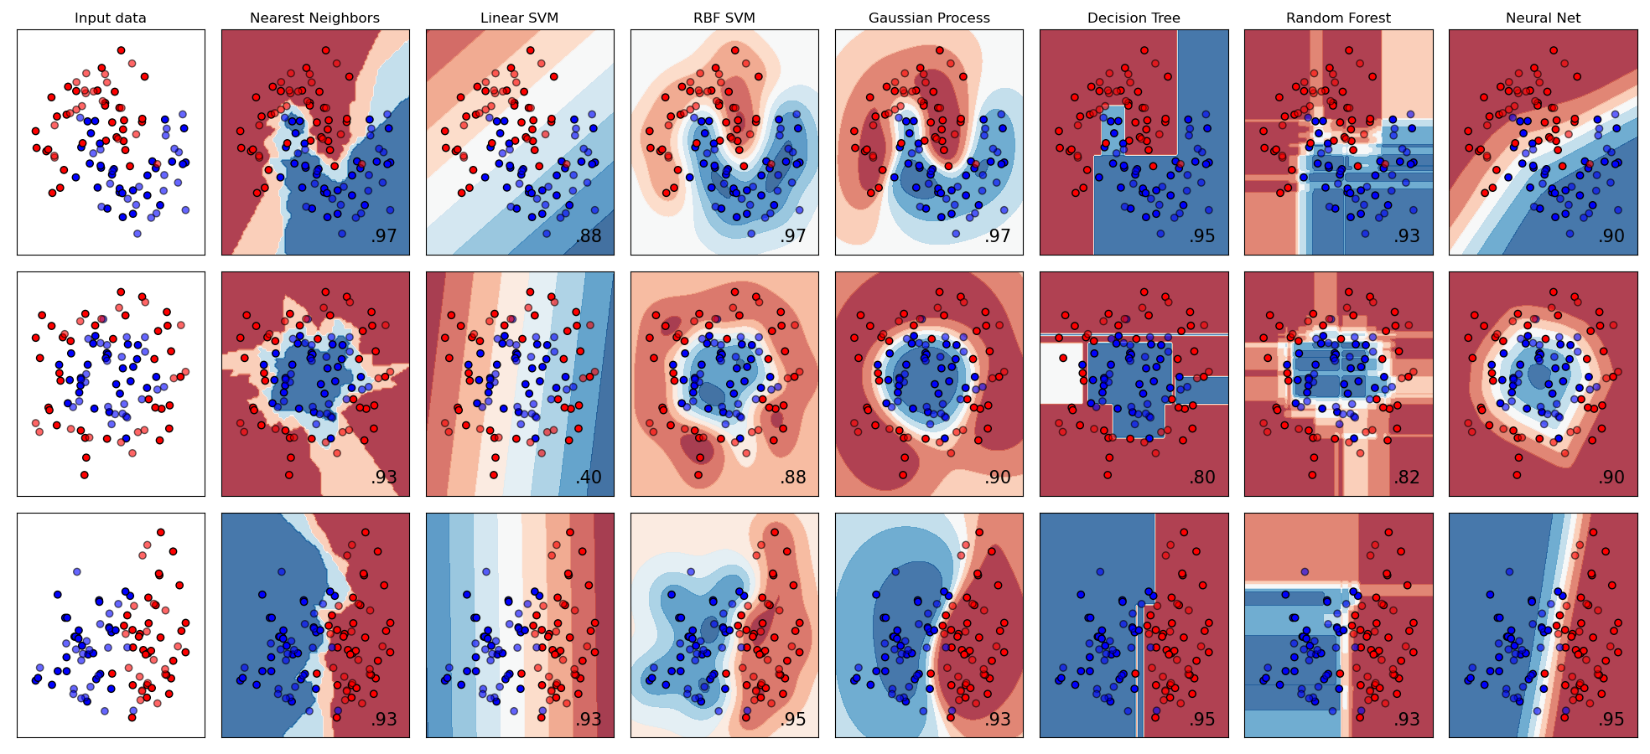
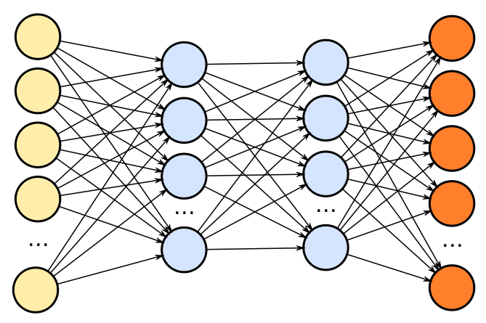
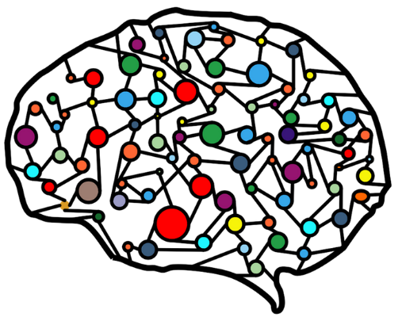
Intuition for deep neural networks
Input features
Output predictions
Intermediate computations
Parameters (i.e. weights)
Notes:
Composed of:
Each circle is a called a unit (will be a number) modelled after neurons
Inputs (represented by circles). These are the features for a given data point.
Outputs (represented by circles). These are the predictions the model makes for a given data point.
Intermediate computations, called layers.
In neural networks, these computations can be anything.
A given intermediate unit can be any function of its inputs (e.g. square root of their sum).
Usually, they are parameterized functions of their inputs (e.g. weighted sum).
The parameters/weights of the network are what is learned during training.
Key feature of deep neural networks is that:
When given enough parameters, they can express (learn) ANY function. Extremely flexible and can fit very difficult datasets with complicated input-output mappings.
Compare this to linear regression, where it only worked well if there were linear relationships.
When they are made deep (i.e. lots of intermediate layers of computation), they often achieve incredible performance.
Inspired by the brain:
Units are like neurons, connections between neurons are the parameters (weights) connecting units.
The brain has a huge amount of neurons (estimated 86 billion) and an even larger amount of neural connections (estimated over 100 trillion). Deep neural networks follow the same approach.

Slide 7
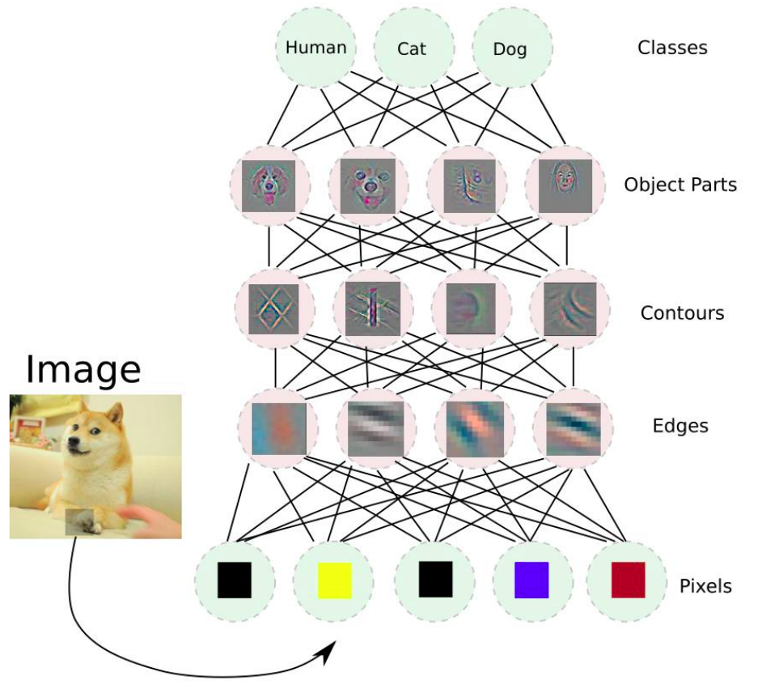
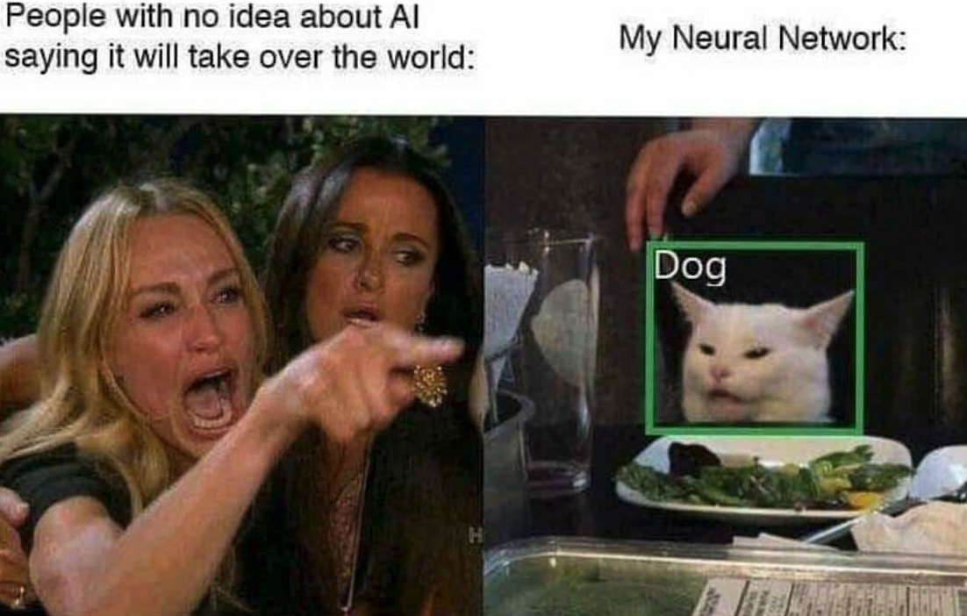
Intuition for deep neural networks
Units learn to respond to increasingly abstract/complex features
Notes:
Layered architecture creates hierarchy in the model.
Hierarchy mimics how we (humans) would solve the problem
Steps towards the solution.
Image classification: very tough for any models learned so far
Can be done using a neural network fairly easily.
Other hierarchy examples:
Speech to text (raw audio→frequencies→syllables→words→sentences)
NLP (raw text→words→phrases→sentences→paragraphs)
Note we don’t specify what each layer finds or does, we just setup the layers and let the neural network discover it on their own.

Slide 8

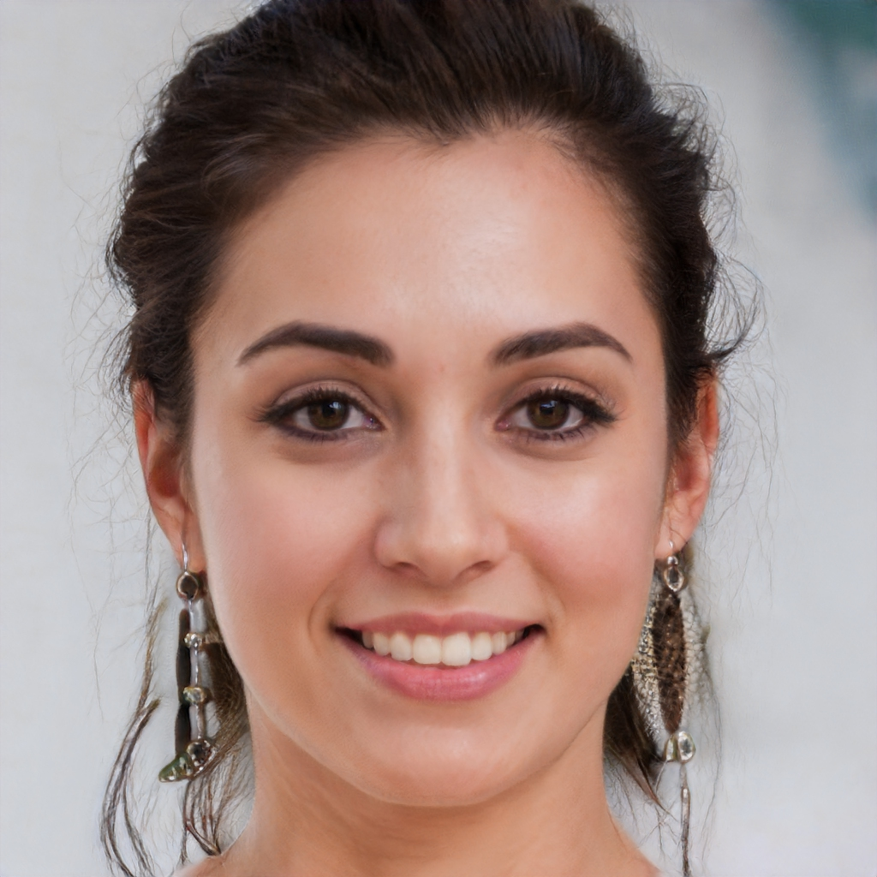
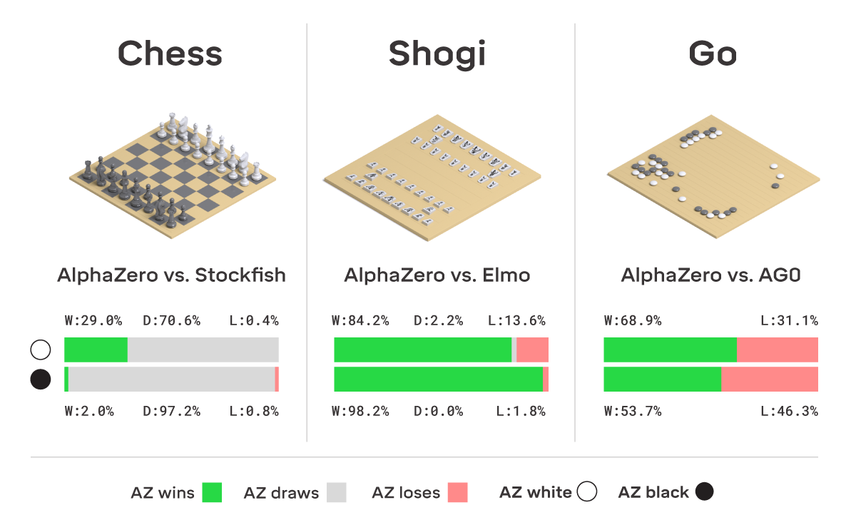
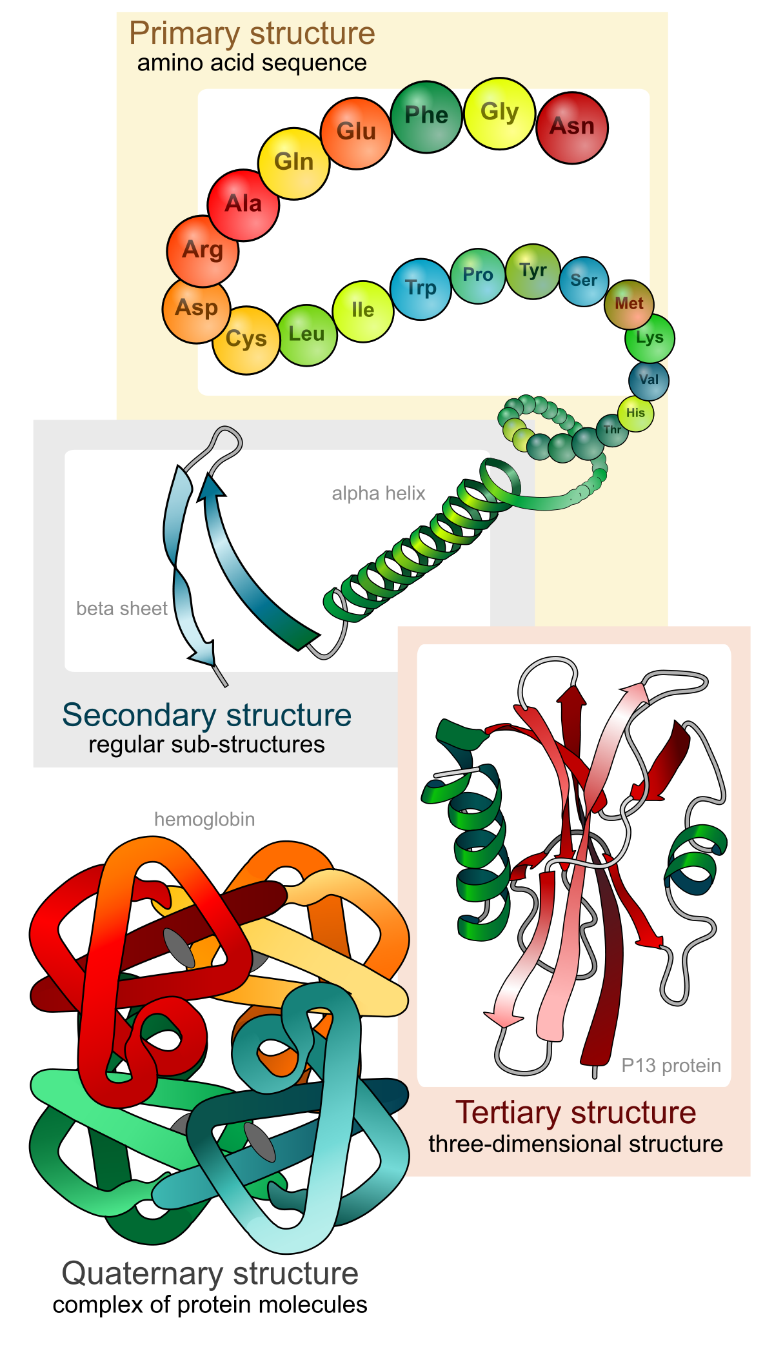
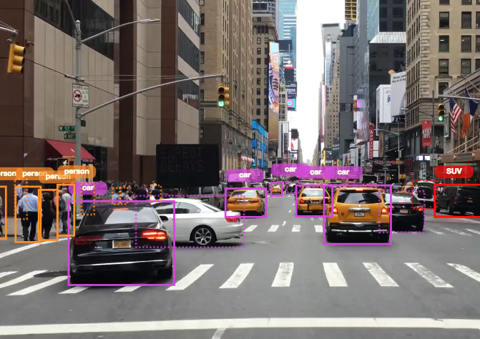

Case studies
Image generation (try and try)
Large Language Models
Challenging games
Protein structure
Self-driving cars
Music generation (try)
Notes:
Protein folding problem
Given sequence of amino acids, what is its structure (this governs its effect in body).
Consider solved (also by Deep mind)
None of this was possible using the models we’ve learned up until now.

Slide 9


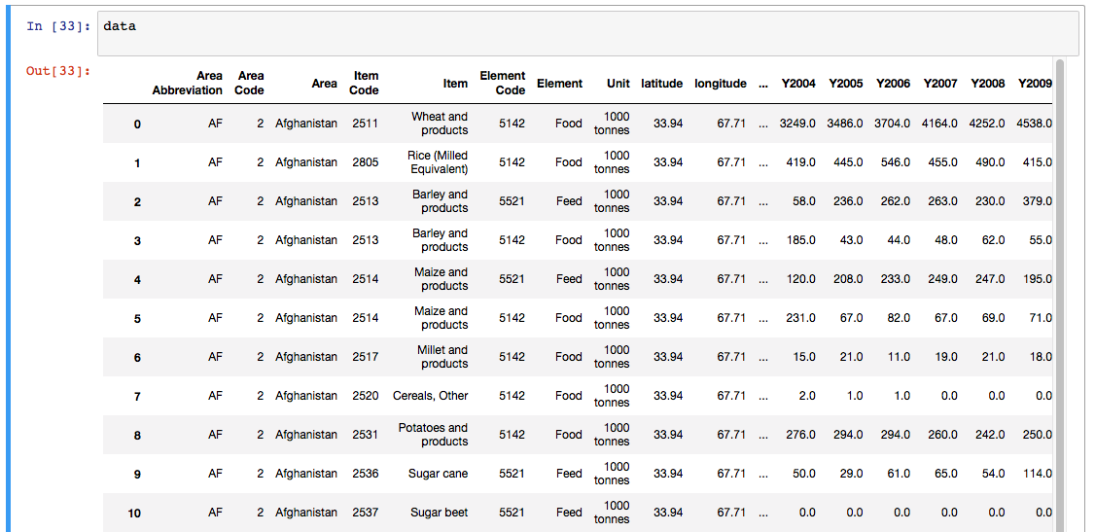
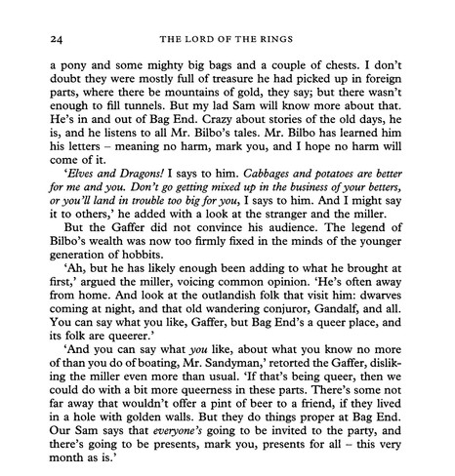
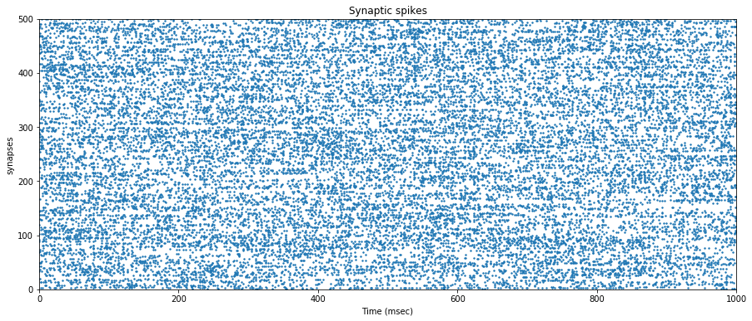
High-dimensional unstructured data
Structured data
Unstructured data
Images
Audio
Data frames
Language/text
Sensors/recordings
Notes:
Best models for structured data often still use XGboost, random forests (not deep learning)
This may change soon though.
Deep learning is great for unstructured data, classic ML models do horrible.

Slide 10
Little preprocessing or feature engineering
Unstructured data statistics
(e.g. image histogram)
Feature selection
One-hot encoding
Outlier removal
Standardization
Nonlinear transformations
(e.g. polynomials)
Denoising
Notes:
Relate back to midterm (flight prediction)
Model didn’t really matter, designing features was what mattered.

Slide 11
Little preprocessing or feature engineering
Unstructured data statistics
(e.g. image histogram)
Feature selection
One-hot encoding
Outlier removal
Standardization
Nonlinear transformations
(e.g. polynomials)
Denoising
Notes:
Generally speaking! Some exceptions for certain types of data, such as audio data when sometimes a model can get better performance working with the spectrogram, which is a feature engineering step.
One interpretation of why we’re able to do this is that much of the important feature engineering, which with other models we do manually, might be performed automatically in the intermediate layers. One theory of why deep learning works is that it might be learning the optimal feature engineering for a given problem.

Slide 12
Caveat: massive datasets
Larger function spaces (e.g. deep neural networks) require more data
More functions can be expressed, more parameters to learn, more data needed to learn them
Sizes of some popular deep learning datasets:
ImageNet (image classification): ~1,000,000 images
MS-COCO (image segmentation): 330,000 images
Amazon reviews (sentiment analysis): ~82,000,000 text reviews
Common voice (speech recognition): ~1,118 hours of audio
Most datasets have at least a few thousand samples (but it’s task-dependent)
Can also use “transfer learning”
Notes:
More parameters means more data required.
DNNs need lots of data to perform better than other models
Can still run with smaller amounts of data, but won’t get desirable results.
DNNs scale better than any other model with increased data size. Performance of other models will saturate, performance of deep neural networks will continue improving (unboundedly).
Transfer learning: instead of starting with a NN with randomized weights, start with a pre-trained NN (trained for a similar task).

Slide 13
What is a deep neural network?

Slide 14
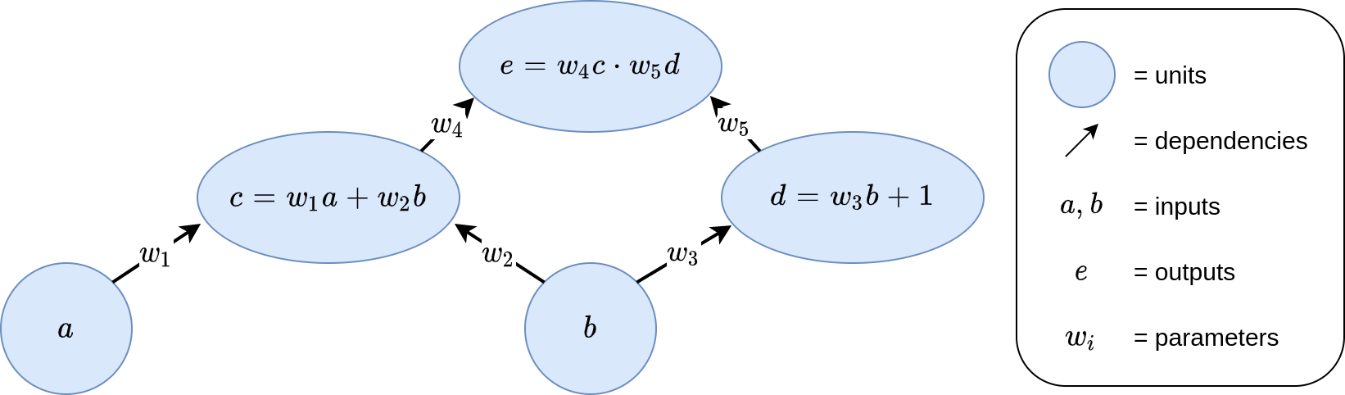
Units, parameters, and computation graphs
Notes:
Inputs are a and b
Output is e
As the parameters vary, you can see that the function from input to output changes too.

Slide 15
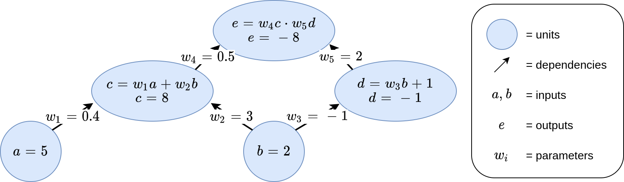
Units, parameters, and computation graphs
Notes:
This is a neural network! Any computation graph is a neural network. It’s a weird neural network because there’s not much regularity in how the units are structured and connected, but it’s a neural network regardless.
There are many different kinds of deep neural networks that have different patterns of connectivity and functional forms. These are called architectures.
There are typically good kinds of architectures for different kinds of data (e.g. MLPs for structured data, CNNs for images, RNNs for language data).
Pattern common to essentially all architectures is that they are typically organized into layers, and there are different types of functions between those layers.

Slide 16
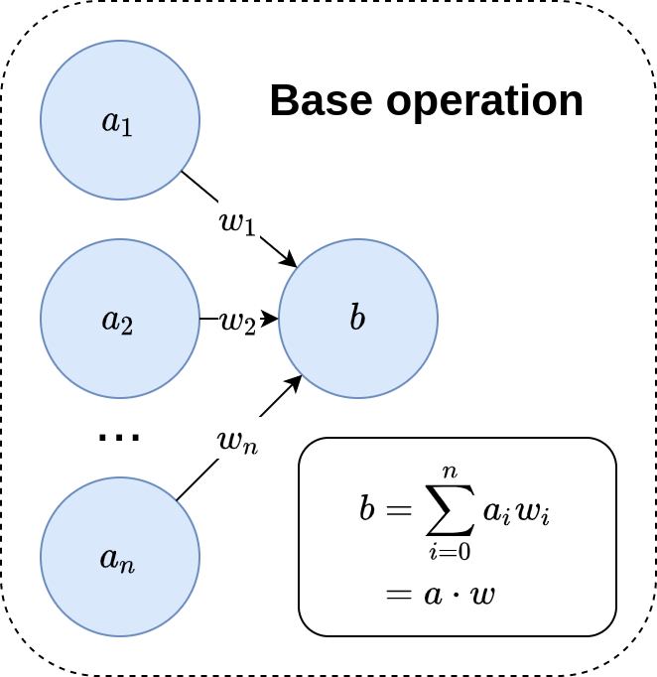
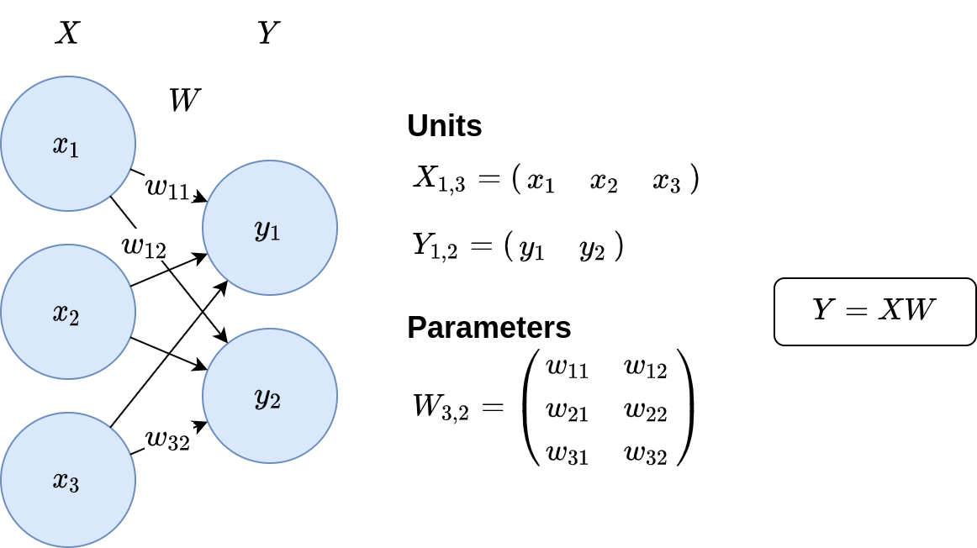
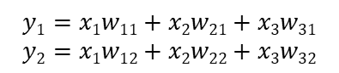
Fully-connected layers - linear regression
$$y1=x1w11+x2w21+x3w31$$
$$y2=x1w12+x2w22+x3w32$$
Notes:
This type of architecture uses what are called fully-connected layers.
Every unit in an input layer is connected to every unit in an output layer. The two layers are fully connected.
Linear Regression is an example of a fully-connected layer.
The base operation in a fully connected layer is a linear combination.

Slide 17
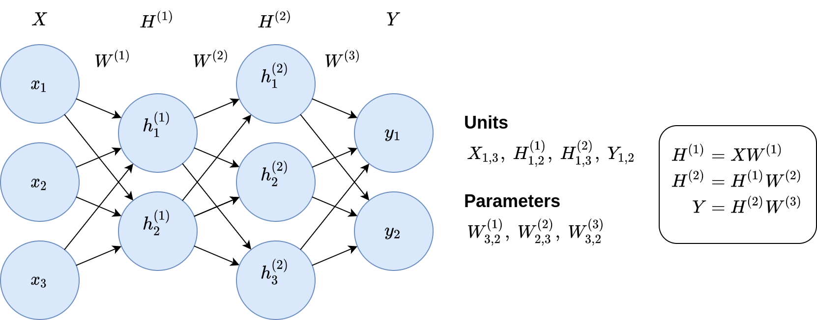
Fully-connected layers - multi-layer perceptron (MLP)
Notes:
Missing one thing. This is still a linear model!

Slide 18
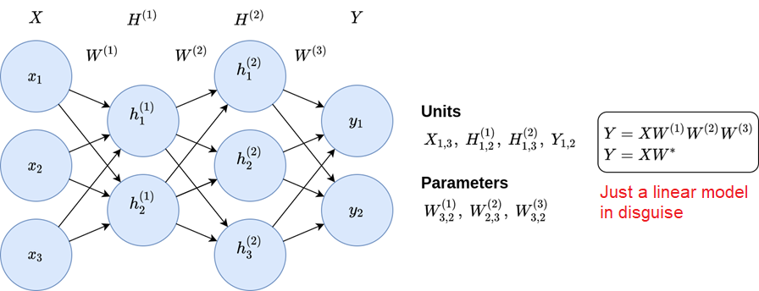
Fully-connected layers - multi-layer perceptron (MLP)
Notes:
Solution: activation functions

Slide 19
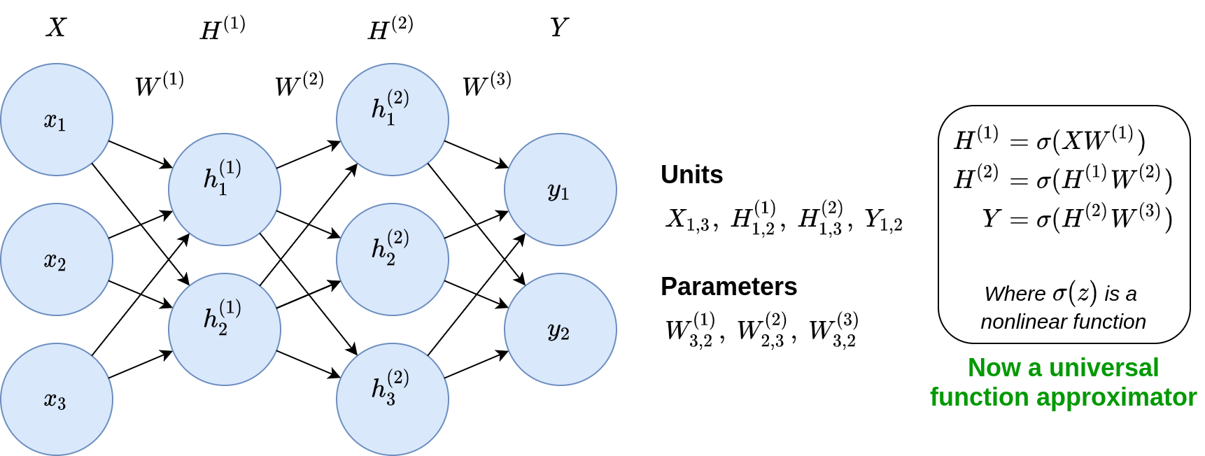
Nonlinearities

Slide 20
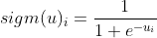
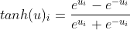
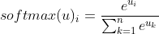
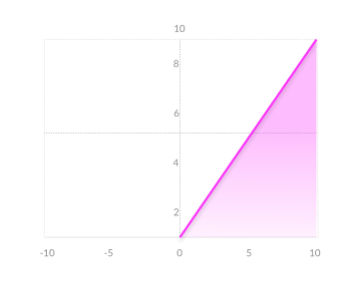
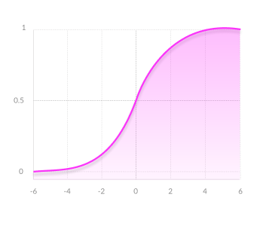
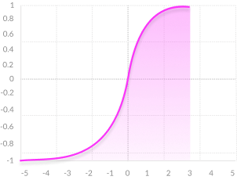
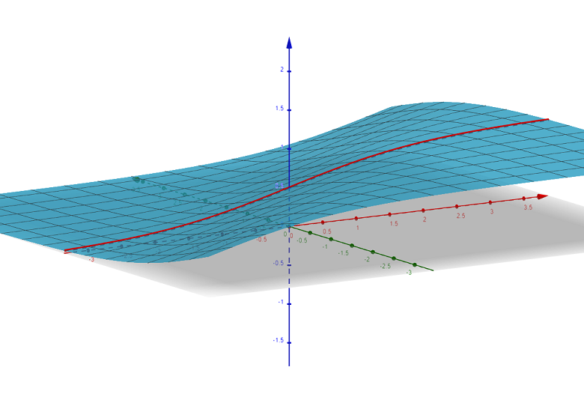
Nonlinearities - common functions
ReLU
Sigmoid
Tanh
Softmax
*Shown for 2 inputs
Works well in practice
Computationally efficient
Dying ReLU problem
Outputs between (0, 1)
Vanishing gradients
Not zero-centered
Outputs between (-1, 1)
Zero-centered
Vanishing gradients
Outputs sum to 1 (good for class probabilities)
Less useful for hidden layers
Notes:
ReLU most common in intermediate layers.
Gives good performance when used in intermediate layers
Sigmoid useful in the output layer (for probabilities)
LSTM puts it in intermediate
Tanh useful if you want output in a range.
LSTM puts it in intermediate
Softmax gets applied to a set of units
Make positive, and make sum to 1 (for probabilties).
Transformers puts it in intermediate
Dying ReLU→get cases where input to a unit is always negative, and thus always evaluates to 0. Not useful.
Vanishing gradients→small max slope of activation function, can lead to very small gradients (very slow convergence if at all)
Zero-centered functions make it easier for a function to model whether its input is strongly positive, negative, or neutral (special values in all cases 1, -1, and 0).

Slide 21
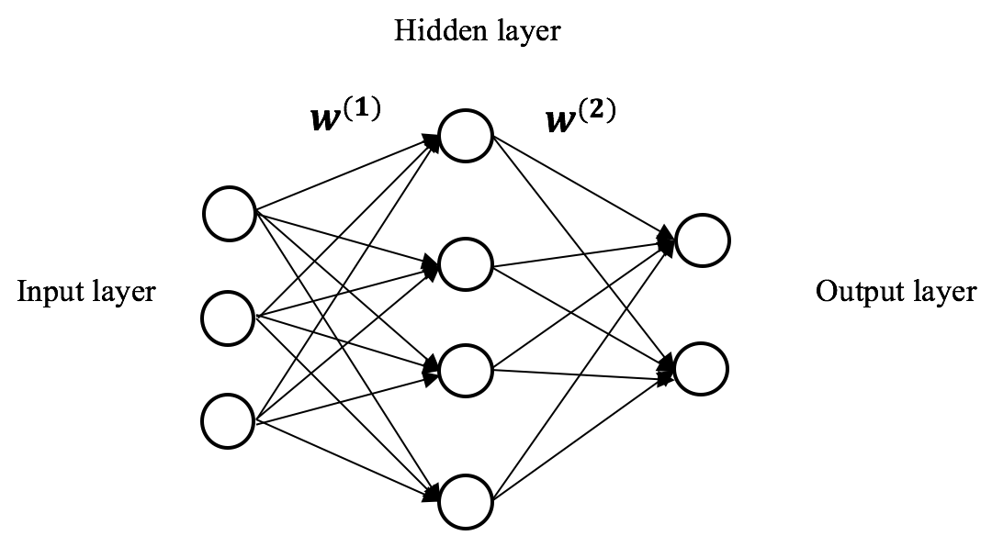
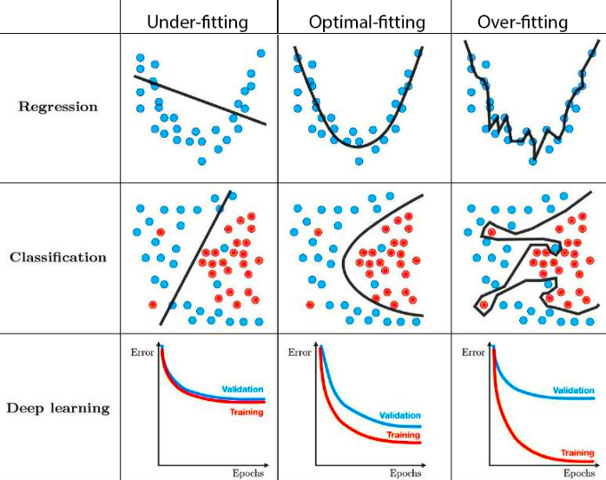
The universal approximation theorem
Theorem: a neural network with 1 hidden layer can approximate any function, if the width of the network (number of hidden units) can be arbitrarily large
In practice, networks that are deep (many hidden layers) are much more effective at learning and converge to better solutions
There is a corresponding universal approximation theorem for depth as well
Notes:
Be careful of overfitting.

Slide 22

Architecture decisions
Several questions arise:
How many layers?
What layer functions?
How many units?
Some answers:
Typically, deeper = better
Different architectures for different data types
Images: Convolutional Neural Networks (CNNs)
Natural language, time series: Recurrent Neural Networks (RNNs)
Treat some decisions (e.g. #units/layer) as hyperparameters
Use state-of-the-art architectures published in research papers
Notes:
MLPs: Tabular/structure data
CNNs: images
RNNs: NLP, time series
Research:
If I have to do image classification but I have some computational budget, what’s the best architecture?
Import architectures that have already been designed/trained for a task similar to yours!
Slightly tune them if needed and then train them on your data.

Slide 23
Training deep neural networks

Slide 24
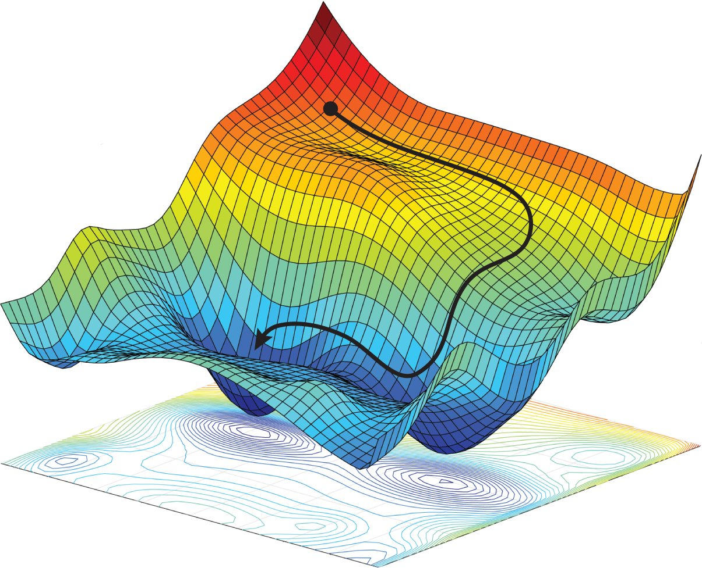

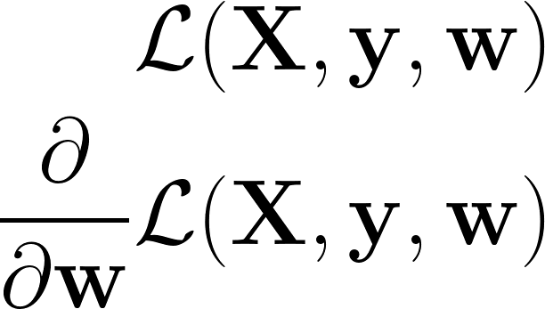
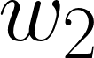
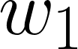
Review: loss functions and gradient descent
Loss function with respect to data, labels, and parameters
Gradient: derivative of loss with respect to parameters
Gradient descent procedure
Initialize the parameters (e.g. randomly)
Compute the gradient of the loss function with respect to the parameters
The loss function would increase if we moved the parameters in the direction of this gradient
Move the parameters in the opposite direction of the gradient so that the loss function would decrease
The parameters are now better because they result in a lower loss. This is the goal of training
Repeat (2) and (3) several times so that the loss gradually decreases
We can always use gradient descent to optimize a set of parameters, so long as the loss function is differentiable with respect to those parameters

Slide 25
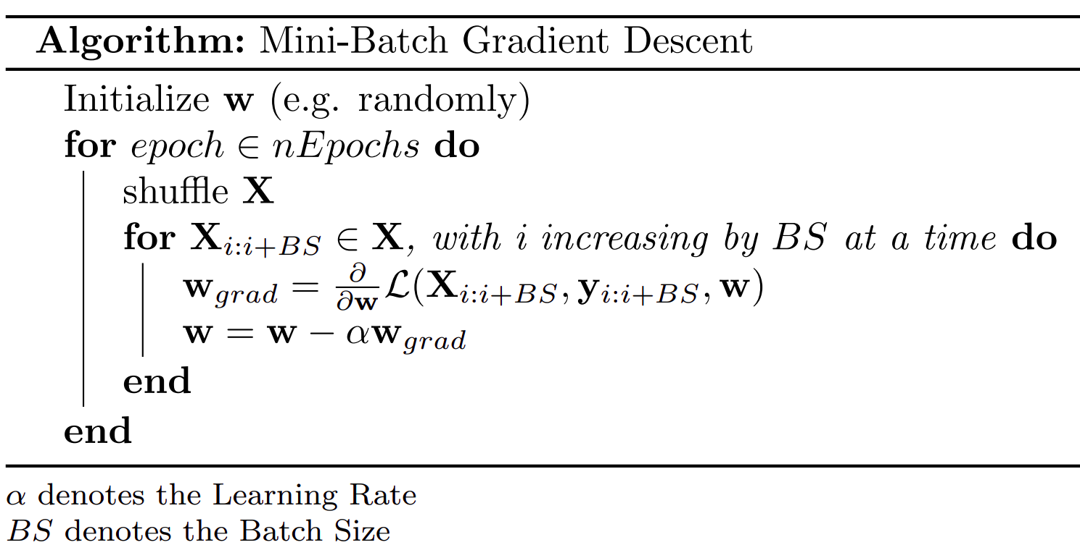
Review: loss functions and gradient descent

Slide 26
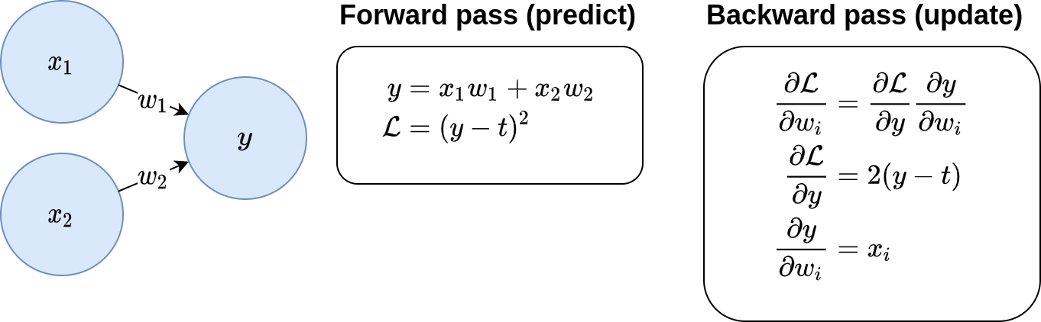
Review: loss functions and gradient descent
Notes:
Just cover forward pass first.

Slide 27
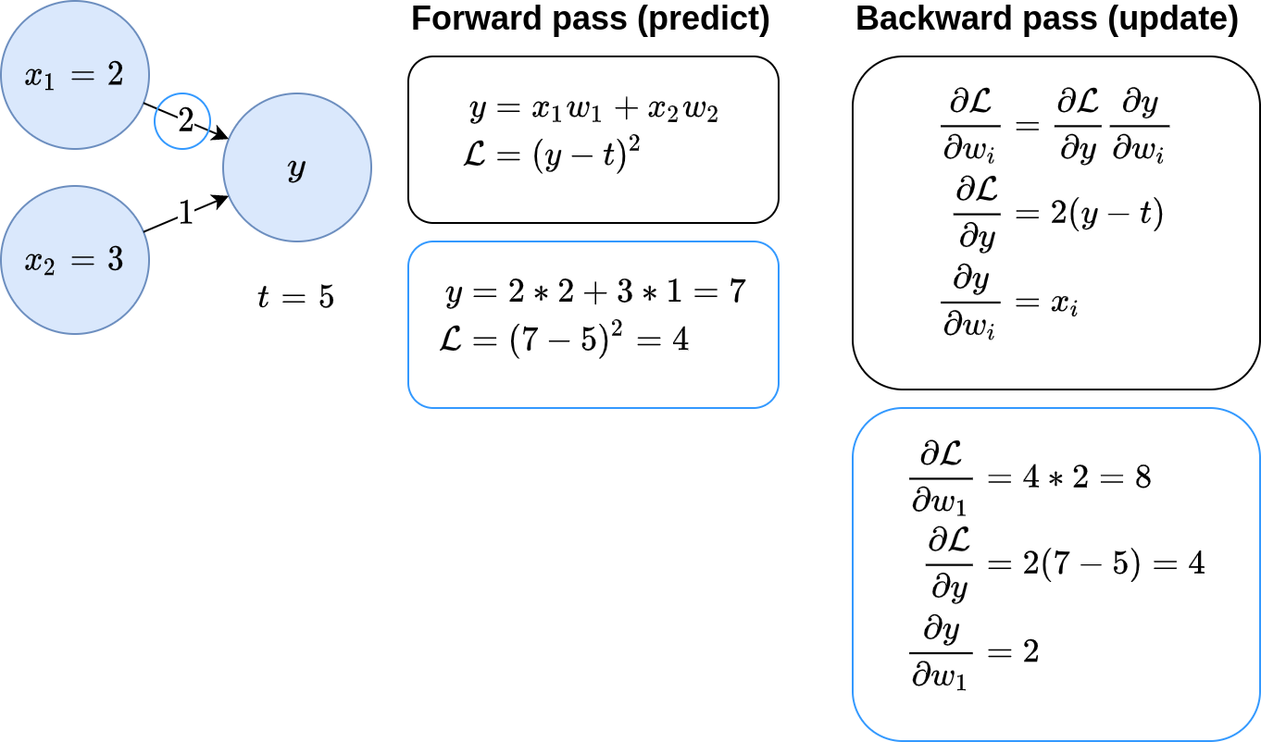
Review: loss functions and gradient descent
Notes:
Once we know the loss (from the forward pass), how do we modify the weights to get a lower loss?
Go over chain rule (and theory behind chain rule).
Pretend learning rate is 0.01 for next slide

Slide 28
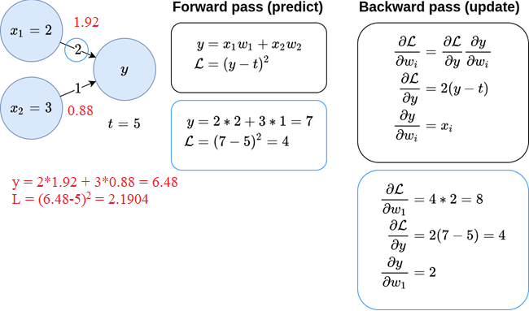
Review: loss functions and gradient descent
Notes:
Notice loss decreases.

Slide 29
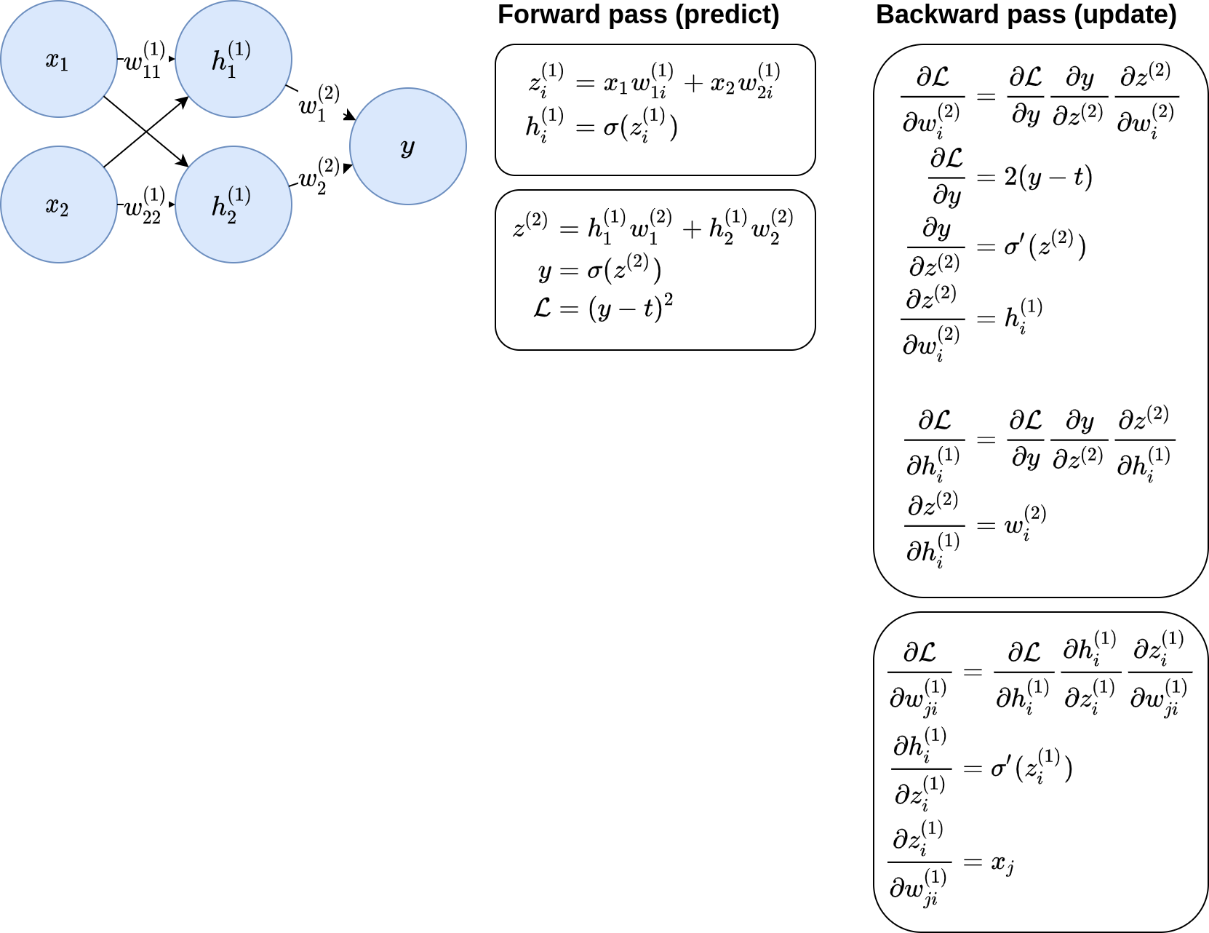
Backpropagation

Slide 30
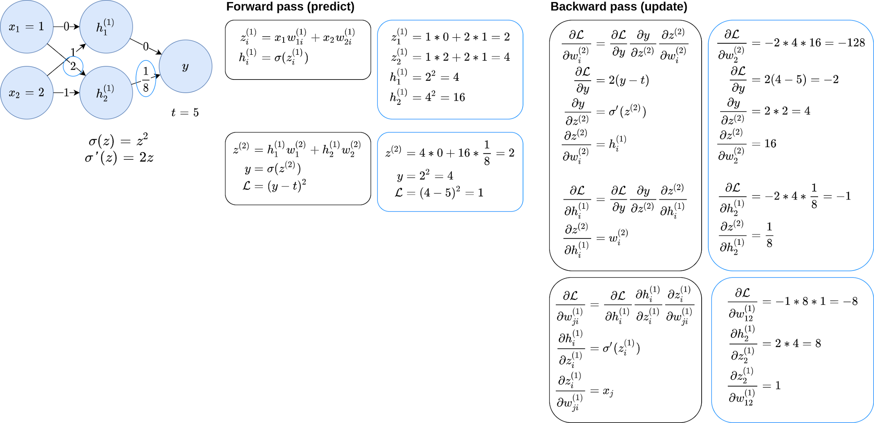
Backpropagation

Slide 31
Deep learning packages in Python
Notes:
These packages prevent you from having to perform derivatives manually (automatic gradient calculation)

Slide 32
PyTorch
import torch
from torch import nn, optim
from torch.utils.data import DataLoader
from torchvision import transforms, datasets
# Prepare the data
train_set = datasets.MNIST('data_dir', train=True,
transform=transforms.ToTensor())
test_set = datasets.MNIST('data_dir', train=False,
transform=transforms.ToTensor())
train_loader = DataLoader(train_set, batch_size=32, num_workers=4)
test_loader = DataLoader(test_set, batch_size=128, num_workers=4)
# Define the model
class Network(nn.Module):
def __init__(self):
super().__init__()
self.fc1 = nn.Linear(28 * 28, 128)
self.relu1 = nn.ReLU(inplace=True)
self.fc2 = nn.Linear(128, 10)
def forward(self, x):
x = x.view(-1, 28 * 28)
h = self.relu1(self.fc1(x))
y = self.fc2(h)
return y
model = Network()
# Train the model
loss_fn = nn.CrossEntropyLoss()
optimizer = optim.Adam(lr=1e-3)
epochs = 5
for e in range(epochs):
for x_batch, label_batch in train_loader:
y_batch = model(x_batch)
loss = loss_fn(y_batch, label_batch)
optimizer.zero_grad()
loss.backward()
optimizer.step()
Paradigm: OOP
High/low-level: Low-level
Popularity: High
API: Easy
Used by: Researchers
Notes:
Code shown does classification of hand-written digits (MNIST dataset)
Code examples on next slide will do the exact same thing.
Also skorch (sk-learn + torch) library to turn PyTorch NN into sklearn-compatible model. Can use it with pipelines, gridsearchcv, call .fit the same way, etc.

Slide 33
TensorFlow
import tensorflow as tf
import tensorflow_datasets as tfds
# Prepare the data
datasets, info = tfds.load(name='mnist', with_info=True, as_supervised=True)
mnist_train, mnist_test = datasets['train'], datasets['test']
def scale(image, label):
image = tf.cast(image, tf.float32)
image /= 255
return image, label
train_data = mnist_train.map(scale).shuffle(1024).batch(32)
test_data = mnist_test.map(scale).batch(1024).batch(128)
# Define the model
random_normal = tf.initializers.RandomNormal()
weights = {
'h': tf.Variable(random_normal([28 * 28, 128])),
'y': tf.Variable(random_normal([128, 10]))
}
biases = {
'h': tf.Variable(tf.zeros([128])),
'y': tf.Variable(tf.zeros([10]))
}
def model(x):
x = tf.reshape(x, [-1, 28 * 28])
h = tf.matmul(x, weights['h']) + biases['b']
h = tf.nn.relu(h)
y = tf.matmul(h, weights['y']) + biases['y']
return tf.nn.softmax(y)
# Train the model
optimizer = tf.optimizers.SGD(1e-3)
def cross_entropy(y_pred, y_true):
y_true = tf.one_hot(y_true, depth=num_classes)
y_pred = tf.clip_by_value(y_pred, 1e-9, 1.)
return tf.reduce_mean(-tf.reduce_sum(y_true * tf.math.log(y_pred)))
@tf.function
def train_step(x, y):
with tf.GradientTape() as g:
pred = model(x)
loss = cross_entropy(pred, y)
trainable_variables = weights.values() + biases.values()
gradients = g.gradient(loss, trainable_variables)
optimizer.apply_gradients(zip(gradients, trainable_variables))
for e in range(epochs):
for x_batch, label_batch in train_data:
train_step(x_batch, label_batch)
Paradigm: Functional
And OOP in 2.0
High/low-level: Low-level
Popularity: Highest
API: difficult
But easier in 2.0
Used by: Industry
Notes:
Notice code is longer, messier and uglier imo
2.0 made it better, but lots of legacy code online uses 1.0
Popular because it’s designed and maintained by google
Good tools for deploying model (don’t want to deploy python, compile into C++ for example)

Slide 34
Keras
import tensorflow as tf
# Prepare the data
mnist = tf.keras.datasets.mnist
(x_train, y_train), (x_test, y_test) = mnist.load_data()
x_train, x_test = x_train / 255.0, x_test / 255.0
# Define the model
model = tf.keras.models.Sequential([
tf.keras.layers.Flatten(input_shape=(28, 28)),
tf.keras.layers.Dense(128, activation='relu'),
tf.keras.layers.Dense(10)
])
# Train the model
loss_fn = tf.keras.losses.SparseCategoricalCrossentropy(from_logits=True)
model.compile(optimizer='adam',
loss=loss_fn,
metrics=['accuracy'])
model.fit(x_train, y_train, batch_size=32, epochs=5)
Paradigm: OOP
High/low-level: High-level
Popularity: High
API: Very easy
Used by: Beginners/industry
Note: It is now a high-level library that comes with TensorFlow
Notes:
What we’ll be using.
Good for beginners (high-level)
Notice short code
Still very popular and powerful
Tensorflow under the hood
Keras is now included when you install Tensorflow

Slide 35
Demo using Keras

